Slide 1

Turtlebot
By:
Dhammapada Mohapatra
Abhinand J Pai
Anubhav Srivastava
Vodela Amith Kumar
Mentors:
Prof.Nagarjuna G
Prof.Jude D’Souza
Mr.Ashish Kumar Pardeshi
Mr.Ravi Sinha
Instructor: Rajib Ranjan Maiti

Slide 2
Selection of Microcontroller:
Microcontroller-Soul of Turtlebot (SoC (or) tiny computer).
Designed to use almost all of its computational power.
It executes the programs stored in its memory, manages other hardware components of the robot.
Commonly used ones are ESP32 and ATMega328P.
In order to select one among these we are going to compare their architectures, computational modules, peripheral modules, power modes and costs of the microcontroller.

Slide 3
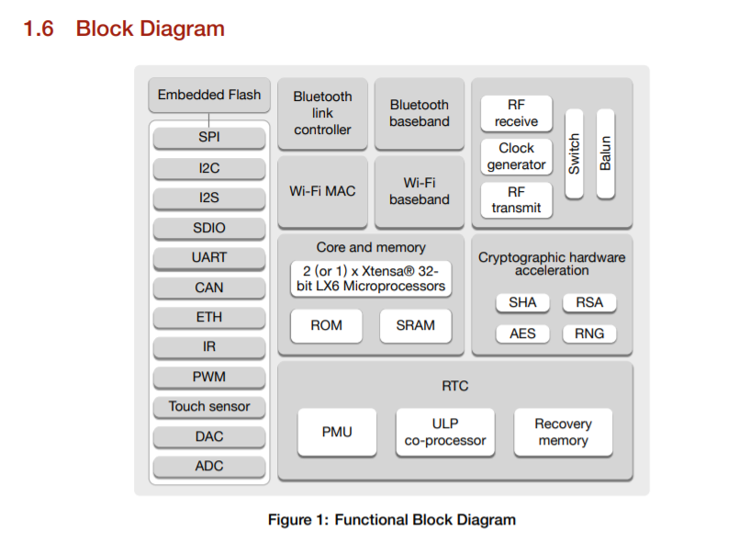

Slide 4
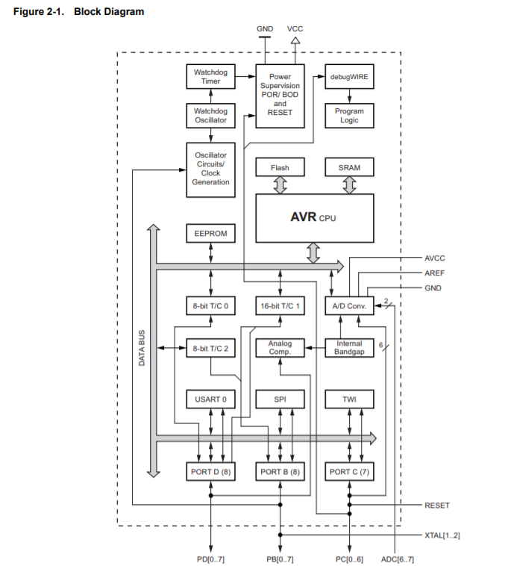

Slide 5
Computational Features
Feature | ESP32(32-bit MCU) | ATMega328P(8-bit MCU)
Architecture(Harvard/Von Neumann) | Harvard | Harvard
Architecture(CISC/RISC) | Enhanced RISC | Enhanced RISC
CPUs | Xtensa LX6(Dual Core) | AVR Core
SRAM(Internal) | 520KB | 2KB
Flash Memory | 4MB | 32KB
ROM | 448KB | 1KB
No of stages in pipelining | 7 | 2
CPU speed | Operating at 160/240 MHz | Operating at 16 MHz
MIPS(Million Instructions Per Second) | Upto 600MIPS | Upto 16MIPS

Slide 6
Memory Architecture:
Harvard Architecture: separate memories and buses for program and data.
Von Neumann architecture: which uses same memory to store both instructions and data so the data bus can be used either to fetch instructions or to load data but both can’t be done at the same time.
Instruction Set Architecture:
RISC Architecture: RISC stands for Reduced Instruction Set Computer: This is the computer which has small and simple instruction set which enables processor to have fewer clock cycles per instruction thereby increasing the speed.
CISC Architecture: which has complex instructions along with simple instructions which take more than one clock cycle for execution. Modern processors are Enhanced RISC processors which have very few CISC instructions.

Slide 7
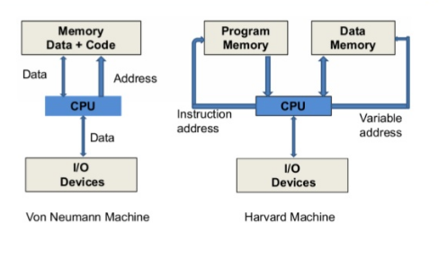

Slide 8
Harvard and Enhanced RISC architectures are common features of both microcontrollers are both are intended to increase the computation speed.
ESP32 is Dual core whereas ATMega328P is Single cored: Having two processors enhances the performance over having a single processor as multiple operations can be done at same time and Dual processors increase MIPS(million instructions per second) .
ESP32 has 7 stages of pipelining whereas ATMega328P has only 2 stages of pipelining: Pipelining is a technique in which multiple instructions are overlapped in execution that is multiple instructions are executed simultaneously. Since ESP32 has more stages of pipelining the clock frequency is more than that of ATMega328P.
The size of internal memory of ESP32 is larger(SRAM, Flash, ROM) than that of ATMega328P.

Slide 9
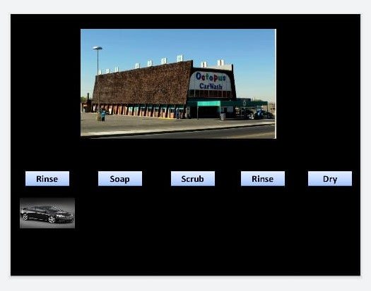
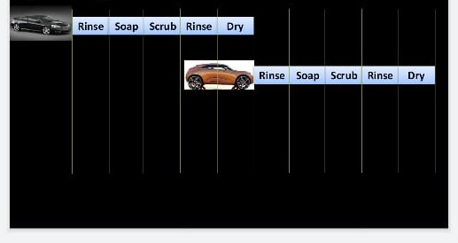
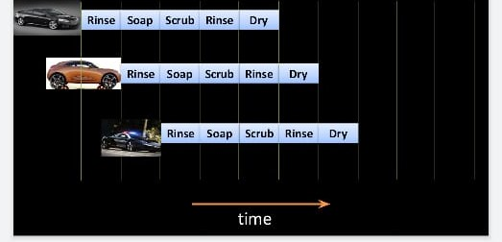
Pipelining Analogy

Slide 10
PeriPHerals

Slide 11
Peripheral | ESP32 | ATMega328P
Bluetooth Link Controller | Yes | No
Bluetooth Baseband | Yes | No
WiFi MAC | Yes | No
RF module | Yes | No
WiFi Baseband | Yes | No
SD/SDIO/MMC Host Controller | Yes | No
SDIO/SPI Slave Controller | Yes | No
ULP Co processor | Yes | No
IR Remote Controller | Yes | No
DAC | Yes(2) | No
CAN Controller | Yes | No
Capacitive Touch Sensors | Yes(10 Capacitive Sensing GPIOs) | No
Hall Sensor | Yes | No
GPIO pins | 34 | 25

Slide 12
Peripheral/Feature | ESP32 | ATmega328P
RTC Memory and RTC peripherals | Yes | No
I2S Controller | Yes | No
UART | Yes | Yes(USART)
SPI | Yes(4) | Yes
ADC | Yes | Yes
I2C Controller | Yes | Yes
Multiplier | 32 bit multiplier | 2 cycle Multiplier(8-bit)
Does it support Floating point unit? | Yes | No
Does it support DSP instructions? | Yes | No
Cryptographic Hardware Accelerators | Yes | No
LEDPWM | Yes | No
MCPWM | Yes | Yes

Slide 13
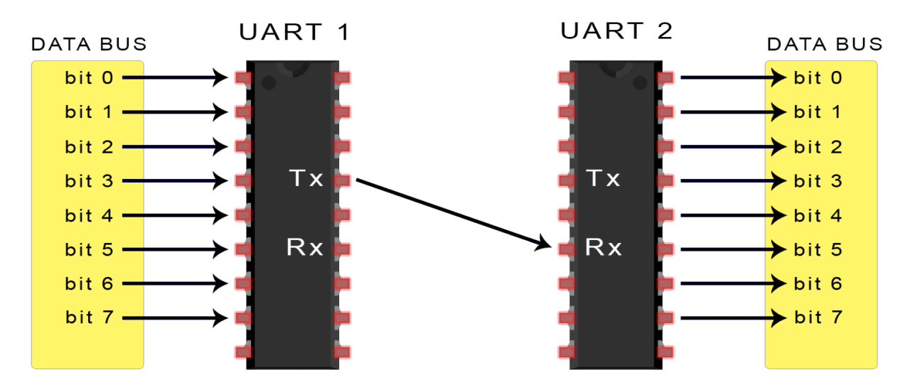
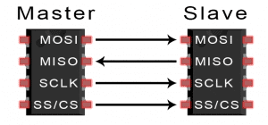

Slide 14
Power consumption of ESP32:
Mode | Range of current
Operating voltage | 1.8V-3.6V(3.3V -Typical voltage)
Active mode | 95mA-240mA(depending on mode of operation)
Modem sleep mode | 20mA-68mA(depending on frequency and number of cores)
Light sleep mode | 0.8mA
Deep sleep mode | 10uA/100uA/150uA
Hibernation mode | 5uA
Power off mode | 1uA

Slide 15
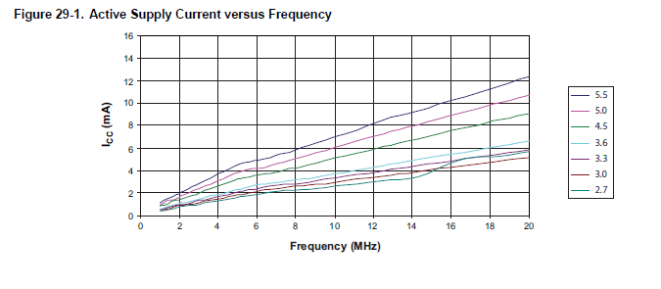
Mode | Range of current
Operating Voltage | 2.7V-5.5V
Active Mode | 1.5mA(3V,4Mhz)=6mA(linear Interpolation to 16Mhz(operating frequency) as typical characteristics are linear)
Power down mode | 1uA at 3V

Slide 16
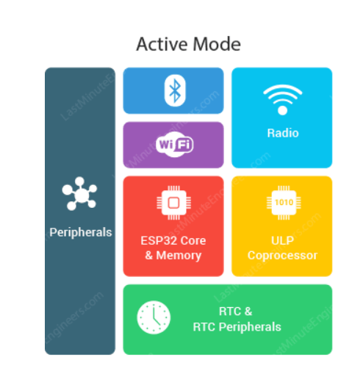
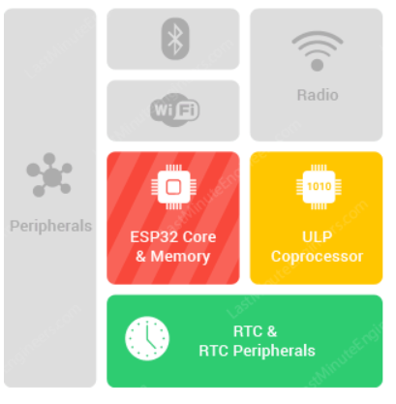
Modem Sleep Mode : Communication modules are disabled
Light Sleep mode is similar to modem sleep mode. In this during sleep time CPU and peripherals are paused by Clock gating so power consumption is reduced.(function should be used).

Slide 17
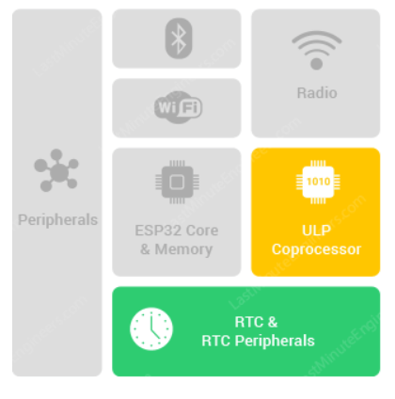
Deep Sleep mode:
We need to use function to push into deep sleep mode.
In this mode power supply is cut-off to Core(CPU and Memory) and peripherals which were clock gated.
ULP co processor, RTC(real time clock) Memory and RTC Peripherals are active.
The code required to be executed by processor & Data recorded during this mode should be stored in RTC memory.

Slide 18
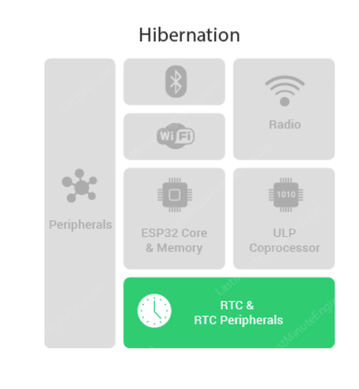
Hibernation mode: In this mode power supply to ULP Coprocessor and RTC memory is cut-off.
Some peripherals and RTC timer are the only active modules whose function is to wake up the ESP32 when required this reduces even more power consumption.

Slide 19
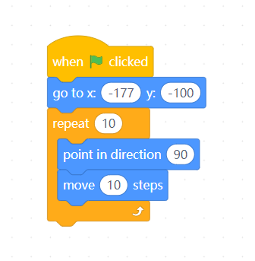
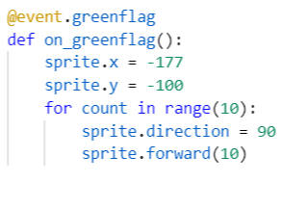
Block programming

Slide 20

Turtlebot – Electromechanical Components and Complete Coding using Arduino IDE through Bluetooth
By Anubhav

Slide 21
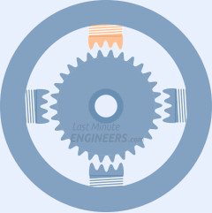
How a Stepper motor works?
Each HIGH pulse sent, energizes the coil, attracts the nearest teeth of the cogged wheel and drives the motor one step.
The sequence of pulses determines the spinning direction of the motor.
The frequency of the pulses determines the speed of the motor.
The number of pulses determines how far the motor will turn.

Slide 22
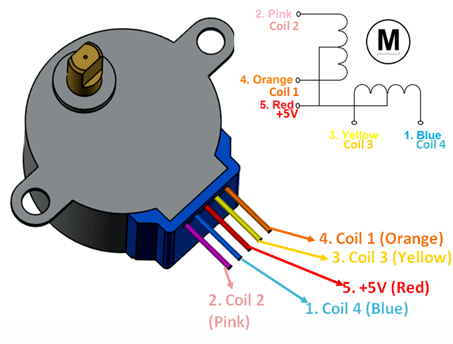
28BYJ-48 Stepper Motor
4 coil unipolar arrangement.
Used in CNC machines, precise control movements, security cameras etc.
Power consumption of motor is around 240mA.
2048 steps/rev.
Max speed: 500 steps/s i.e. around 4s. To compete one rev.
Notes:
One of the best things about these motors is that they can be positioned accurately, precise in their movement and they are quite reliable since the motor does not use contact brushes.downside:it hungry for power and consume power even when they are not moving. best to power it directly from an external 5V power supply rather than drawing that power from the Arduino. Consumes high current so need a driver.

Slide 23
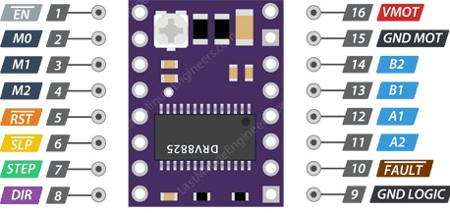
DRV8825 Motor Driver
The DRV8825 stepper motor driver has output drive capacity of up to 45V and lets you control one stepper motor at up to 2.2A output current per coil.

Slide 24
Pinout details
VMOT & GND MOT supplies power for the motor which can be 8.2V to 45V.
Microcontroller’s ground should be common with GND LOGIC pin.
M0, M1 & M2 are step size(resolution) selector inputs. By setting appropriate logic levels to these pins we can set the motors to one of the six step resolutions.
STEP input controls the mirosteps of the motor. Each HIGH pulse sent to this pin steps the motor by number of microsteps set by Microstep Selection Pins.
DIR input controls the spinning direction of the motor. Pulling it HIGH drives the motor clockwise and pulling it LOW drives the motor counterclockwise.
EN Pin is active low input, when pulled LOW(logic 0) the DRV8825 driver is enabled.
SLP Pin is active low input. Meaning, pulling this pin LOW puts the driver in sleep mode, minimizing the power consumption.
RST is also an active low input. When pulled LOW, all STEP inputs are ignored, until you pull it HIGH.
FAULT goes LOW whenever the H-bridge FETs are disabled as the result of over-current protection or thermal shutdown.
B2, B1, A1 & A2 are driver output pins. These are connected to the stepper motor.
Notes:
STEP: The faster the pulses, the faster the motor will rotate
FAULT: Actually the Fault pin is shorted to SLEEP pin so, whenever the Fault pin is driven LOW, the whole chip is disabled. And it remains disabled until either RESET, or Motor Voltage VMOT is removed and reapplied..
M0,M1&M2:These three microstep selection pins are pulled LOW by internal pull-down resistors, so if we leave them disconnected, the motor will operate in full step mode.
EN: by default is pulled low.

Slide 25
OVERVIEW
DRAWING THE SCHEMATIC DIAGRAM USING KICAD.
MAKING THE CONNECTIONS.
WIRELESS CONTROL
CONFIGURING BLUETOOTH ON ESP32
SETTING UP STATION MODE USING WiFi ON ESP32.
BATTERY MANAGEMENT SYSTEM.
TESTING THE CODE FOR ACCURACY.
LINKS

Slide 26
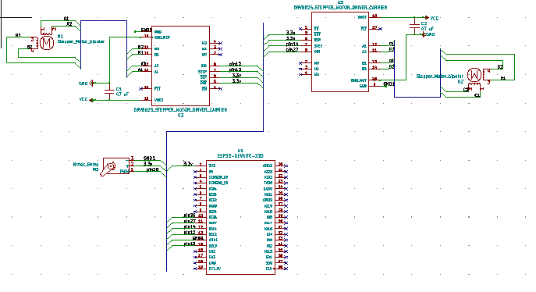
DRAWING SCHEMATIC DIAGRAM USING KICAD

Slide 27
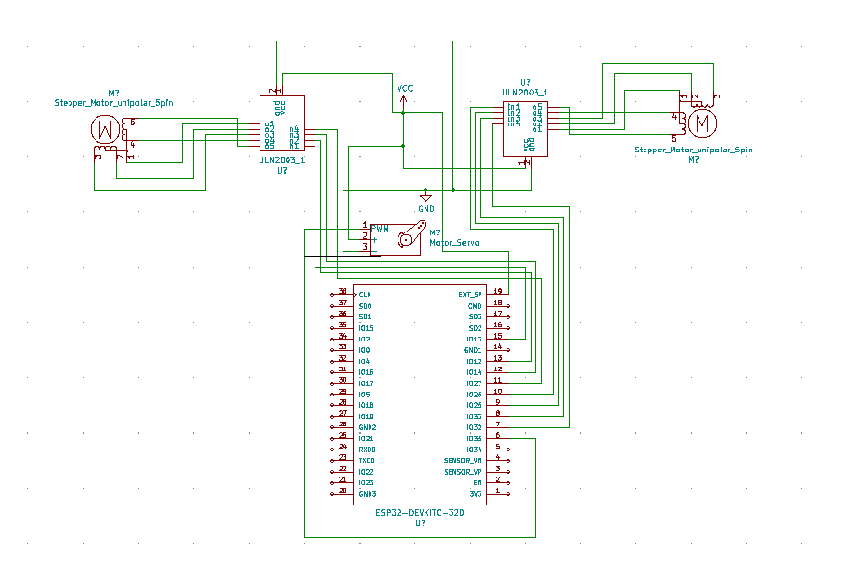
Making the schematic more presentable

Slide 28
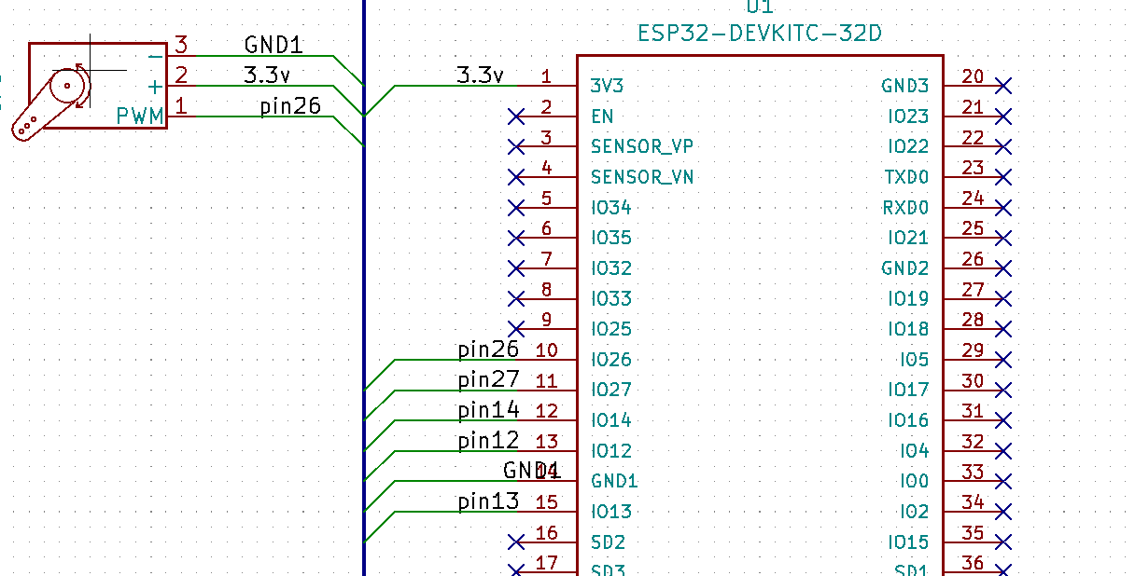
Using buses and net names

Slide 29
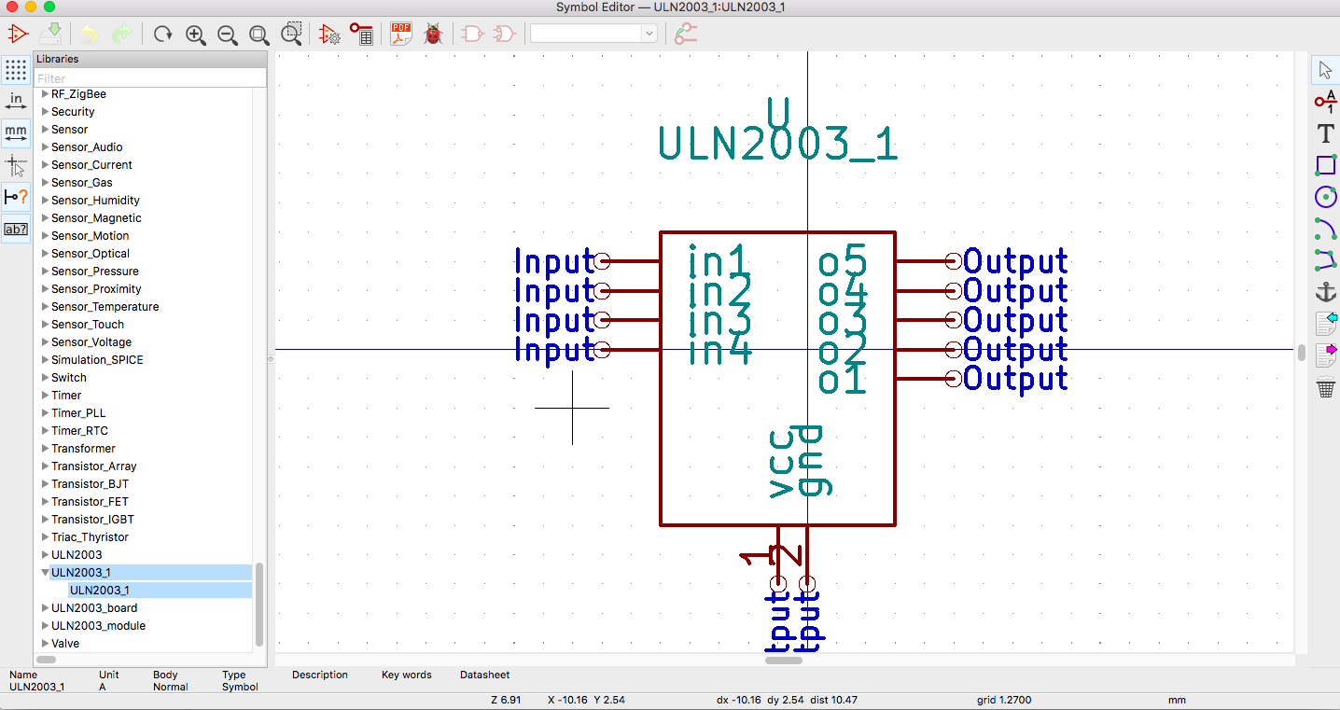
Editing The Symbol Library

Slide 30
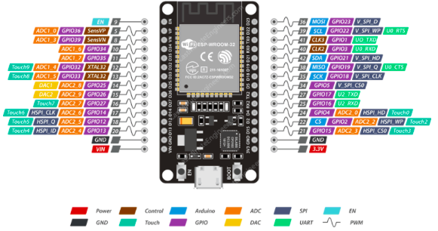
MAKING THE CONNECTIONS
ESP32

Slide 31
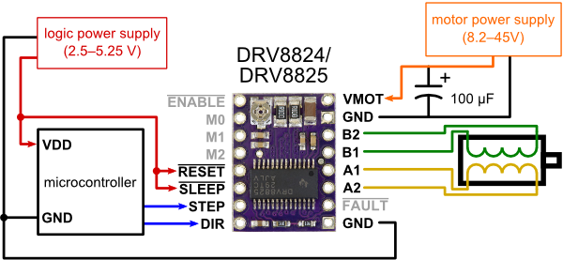

Slide 32
28BYJ-48 5V STEPPER MOTOR

Slide 33
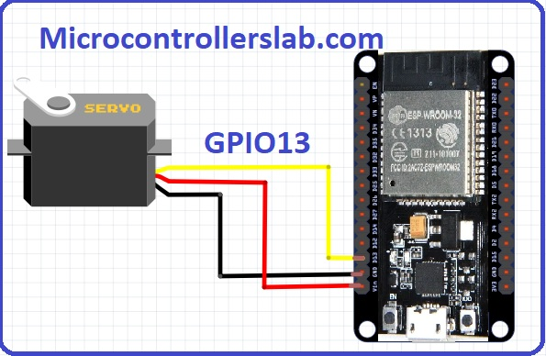
SERVO MOTOR SG90

Slide 34
Mblock : Python based open source software in which ESP32 device libraries are installed.
We were able to connect the robot to this software but the code wasn’t being uploaded on it(Due to fermata problem).
It has a pen extension but it was only able to work with the sprite. Pen extension cannot control servo.
Upload mode: The program to be executed is compiled and uploaded onto robot and robot executes the code without any connection to the laptop.
Live mode: interface sends commands one by one to the robot and robot executes each command as it arrives. Robot remains connected to the laptop and no compilation and uploading step.
Advantage of Live Mode: As there is no compilation or uploading step, we can create simple commands, see them execute and solve the problems if any occurring while the command is executed.

Slide 35
Upload mode is better when quick response from the robot is needed as the code runs fast, latency will be very less compared to live mode so that reaction is quick.
KB IDE: C++ based, open source by which we were able to interface the robot.
No option for creating new blocks.
Pictoblox: Majorly based on Javascript through which we were able to interface the robot.
Not open source so can’t edit the source code to create blocks but can create new blocks from existing blocks.
Snap4Arduino:Javascript based open source software but it was not compatible with ESP32 board.

Slide 36
ESP32 is configured as Asynchronous Webserver as there is no need for periodically executing the handle-client function separately.(need not be active can automatically go to one of the sleep modes for power saving.
GET requests are being used to send data to server from client.(less data no need of security for that data).
Station Mode: ESP32 connects to existing WiFi network, gets IP address from the server which we display on serial monitor and this can be used for the webpages to be delivered by MCU.
SoftAP Mode: Microcontroller creates own WiFi network with its own SSID and IP address . SoftAP as it is not wired.
Advantage: Can operate irrespective of credentials of WiFi local network.

Slide 37
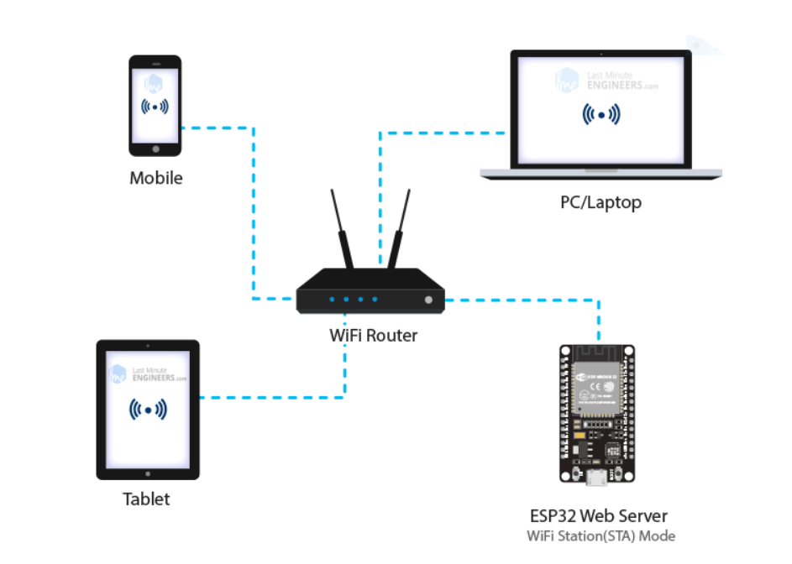
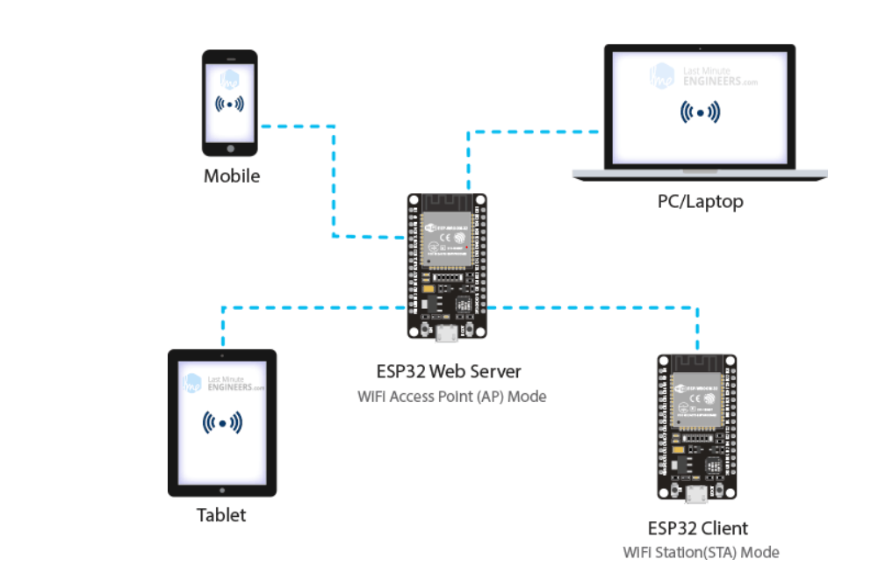

Slide 38
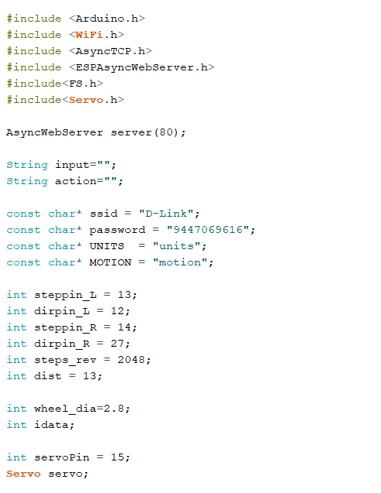
WiFi Code

Slide 39
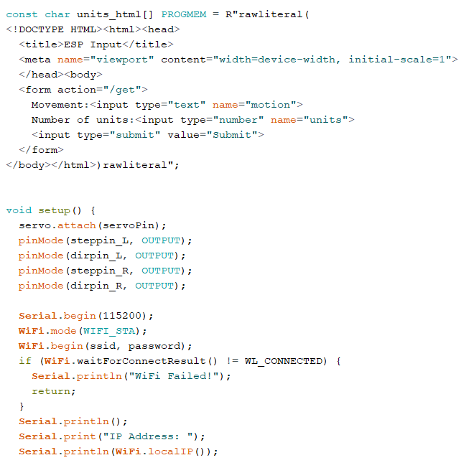

Slide 40
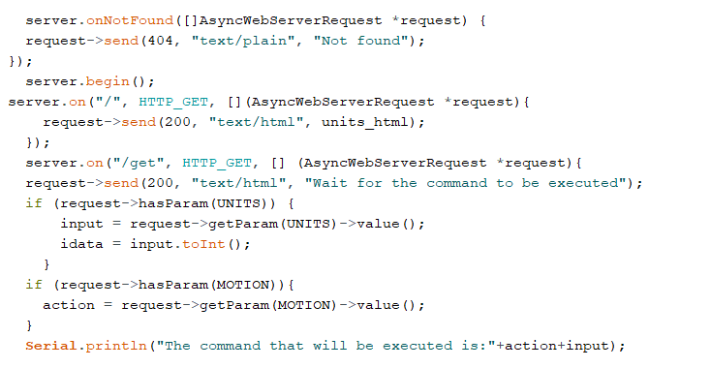

Slide 41
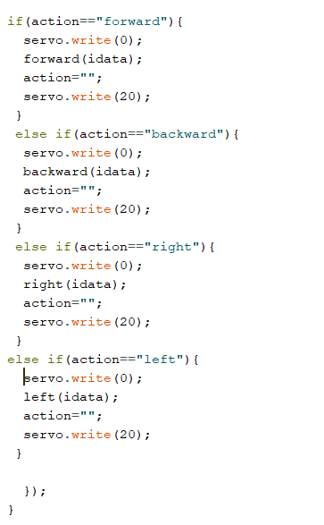

Slide 42
Complete Coding on ESP32 using Arduino IDE – Turning the Bot at any angle, equation of straight line to drawing graph and drawing circle
#include "BluetoothSerial.h“
#include <AccelStepper.h>
#include <MultiStepper.h>
#include <Servo.h>
#include "math.h“
// Check if Bluetooth configs are enabled
#if !defined(CONFIG_BT_ENABLED) || !defined(CONFIG_BLUEDROID_ENABLED)#error Bluetooth is not enabled! Please run `make menuconfig` to and enable it#endif
String message;
int servoPin = 15; int f=1,b=1,r=1,l=1,ln=1,c=1;
AccelStepper motorL(1, steppin_L, dirpin_L);AccelStepper motorR(1, steppin_R, dirpin_R; Multisteppers steppers;
Servo servo; BluetoothSerial SerialBT; //Servo object, and Bluetooth object
int steppin_L = 13;
int dirpin_L = 12;
int steppin_R = 14;
int dirpin_R = 27;
int steps_rev = 2048;
int dist = 13; //Distance between 2 wheels of turtlebot
float wheel_dia=2.8;

Slide 43
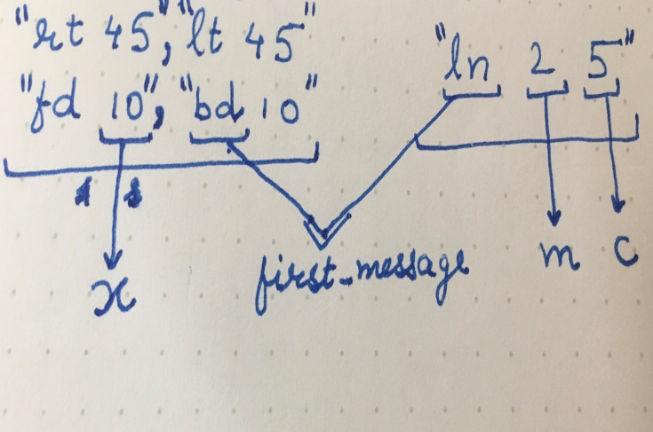
void setup() {
servo.attach(servoPin);
pinMode(steppin_L, OUTPUT);
pinMode(dirpin_L, OUTPUT);
pinMode(steppin_R, OUTPUT);
pinMode(dirpin_R, OUTPUT);
Serial.begin(115200);
SerialBT.begin("ESP32"); // Bluetooth device name
Serial.println("The device started, now you can pair it with bluetooth!");}
void loop() {
// Read received messages
if (SerialBT.available()){
String instr = SerialBT.readString();}
int single_instr=instr.indexOf(',’);
int last_instr=instr.indexOf('\n’);
if(single_instr!=-1 && (f+b+r+l+ln+c)/6==1) {
message=instr.substring(0,single_instr);
instr.remove(0,single_instr+1); }
else {
if(last_instr!=-1 && (f+b+r+l+ln+c)/6==1)
message=instr; instr=""; }
1
2
String first_message=message.substring(0,2);
String second_message=message.substring(3);
int index_of_space = second_message.indexof(" ");
if(index_of_space == -1){
double x = second_message.toDouble(); // x is degrees
} else{
String third_message = second_message.substring(0,index_of_space); //slope
String fourth_message = second_message.substring(index_of_space+1); //inter.
double m = third_message.toDouble(); // m is slope
double c = fourth_message.toDouble(); } // c is y-intercept

Slide 44
if (first_message=="fd"){
servo.write(90); //pen down
forward(x);
servo.write(0); //pen up
message = "";
SerialBT.print(“forward command executed”);
}else if (first_message=="rt"){
servo.write(90); //pen down
right(x);
servo.write(0); //pen up
message = "";
SerialBT.print(“right command executed”);
}else if(first_message=="lt"){
servo.write(90); //pen down
left(x);
servo.write(0); //pen up
message = "";
SerialBT.print(“left command executed”);
} else if(first_message=="bd"){
servo.write(90); //pen down
backward(x);
servo.write(0); //pen up
3
} else if(first_message=="ln"){
line(m,c); message = "";
SerialBT.print(“line command executed”);
} else if(first_message==“cl"){
circle(x); message = "";
SerialBT.print(“circle command executed”);
}}

Slide 45
All Functions
void forward(double distance) {
int steps = step(distance);
digitalWrite(dirpin_L, LOW);
digitalWrite(dirpin_R, HIGH);
for (int i = 0; i < steps; i++) {digitalWrite(steppin_L, LOW); digitalWrite(steppin_R, LOW); digitalWrite(steppin_L, HIGH); digitalWrite(steppin_R, HIGH); delay(5); }}
void backward(double distance) {
int steps = step(distance);
digitalWrite(dirpin_L, HIGH);
digitalWrite(dirpin_R, LOW);
for (int i = 0; i < steps; i++) {digitalWrite(steppin_L, LOW); digitalWrite(steppin_R, LOW); digitalWrite(steppin_L, HIGH); digitalWrite(steppin_R, HIGH); delay(5); }}
void left(double degrees) {
double rotation = degrees / 360;
double distance = dist * 3.14 * rotation;
int steps = step(distance);
digitalWrite(dirpin_L, HIGH);
digitalWrite(dirpin_R, HIGH);
for (int i = 0; i < steps; i++) {digitalWrite(steppin_L, LOW); digitalWrite(steppin_R, LOW); digitalWrite(steppin_L, HIGH); digitalWrite(steppin_R, HIGH); delay(5); }}
void right(double degrees) {
double rotation = degrees / 360;
double distance = dist * 3.14 * rotation;
int steps = step(distance);
digitalWrite(dirpin_L, LOW);
digitalWrite(dirpin_R, LOW);
for (int i = 0; i < steps; i++) {digitalWrite(steppin_L, LOW); digitalWrite(steppin_R, LOW); digitalWrite(steppin_L, HIGH); digitalWrite(steppin_R, HIGH); delay(5); }}
void circle(double r){
double r1 = r - dist/2;
double r2 = r + dist/2;
int steps_L = step(2*3.14*r1);
int steps_R = step(2*3.14*r2);
long positions[2];
positions[0] = steps_L;
positions[1] = steps_R;
steppers.moveTo(positions);
steppers.runSpeedToPosition(); // Blocks until all are in position
}
int step(float distance){
int steps = distance * steps_rev / (wheel_dia * 3.1412);
return steps;
}

Slide 46
void line(double slope, double intercept){
servo.write(0); // pen up
int steps = step(intercept);
if(intercept < 0){ // for backward movement
digitalWrite(dirpin_L, HIGH); digitalWrite(dirpin_R, LOW);
} else { // for forward movement
digitalWrite(dirpin_L, LOW);
digitalWrite(dirpin_R, HIGH); }
for (int i = 0; i < steps; i++) { // moving to y-intercept
digitalWrite(steppin_L, HIGH);
digitalWrite(steppin_R, HIGH);
delay(5);
digitalWrite(steppin_L, LOW);
digitalWrite(steppin_R, LOW);
delay(5); }
double radians=atan(slope);
double degrees = radians*180/3.14;
degrees = degrees-90;
if(degrees<0){ // i.e. right rotation
degrees = degrees*(-1);
right(degrees);
servo.write(90); // pen down
forward(10); } else { // i.e. left rotation
left(degrees);
servo.write(90); // pen down
forward(10); }}

Slide 47
Wireless control of Turlebot
Bluetooth
Bluetooth serial monitor can be used to control the bot.
WiFi
Turtlebot can be controlled using a simple webpage.

Slide 48
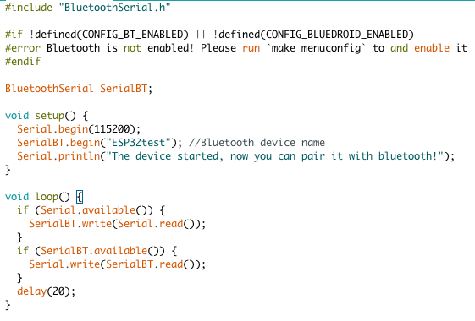
Configuring Bluetooth for ESP32

Slide 49
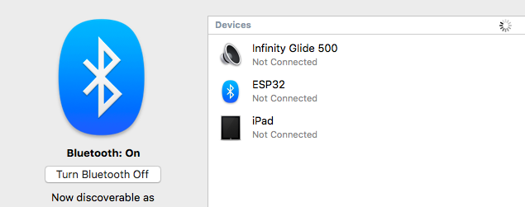
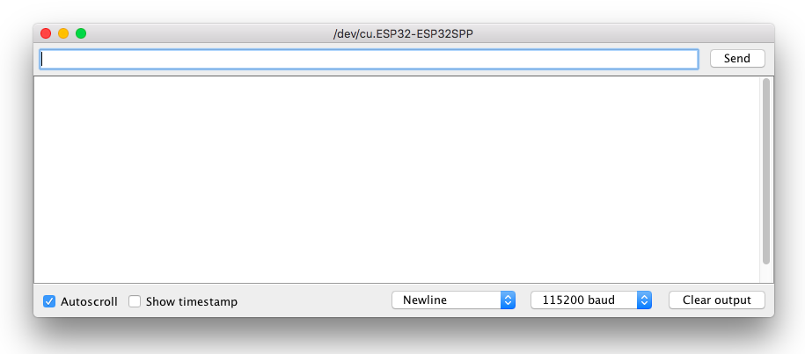

Slide 50
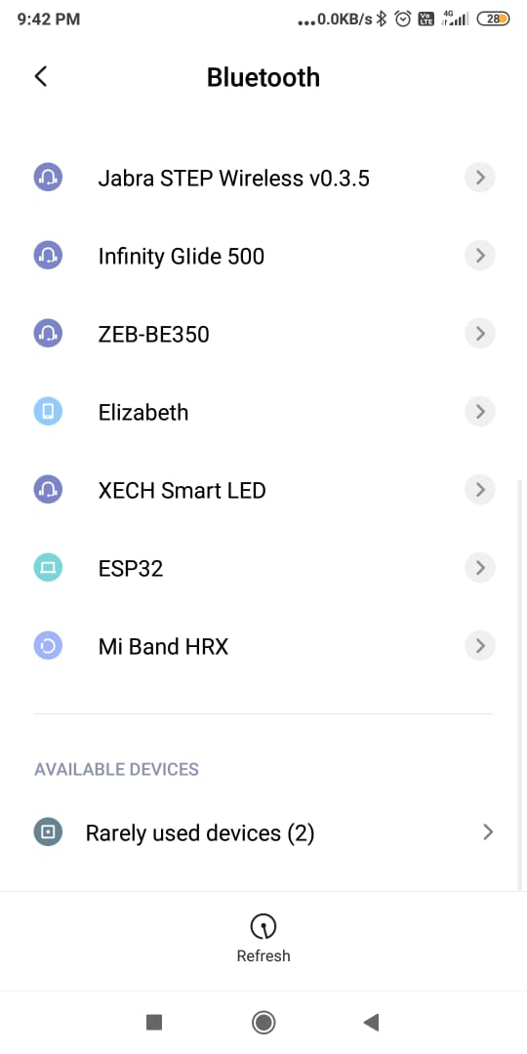
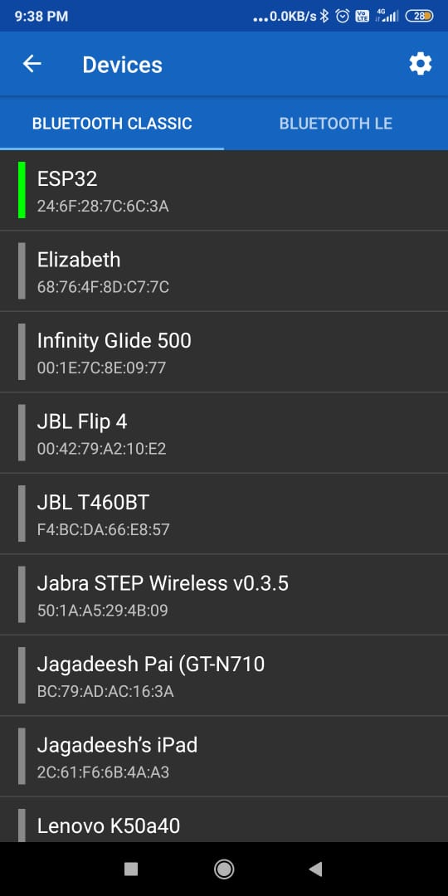
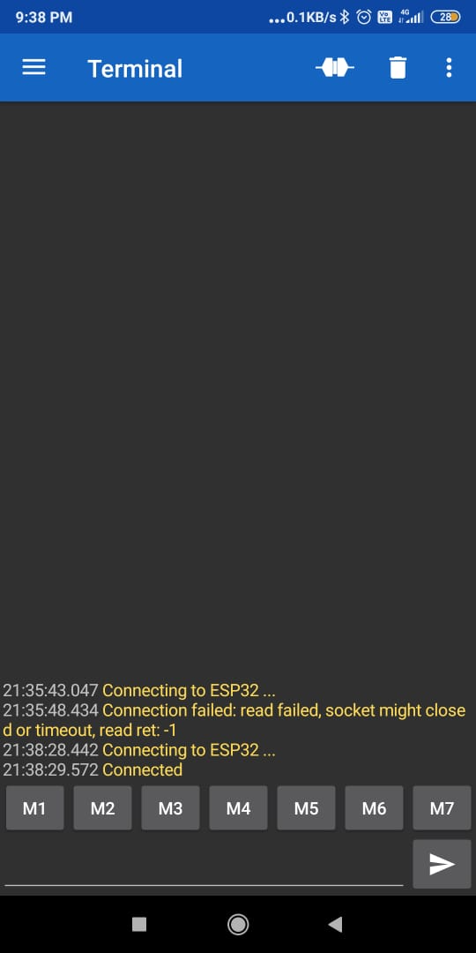

Slide 51
Commands
Forward- fd (dist. In cm.)
Backward – bd (dist. In cm.)
Right- rt (angle in degrees)
Left – lt (angle in degrees)
Line – ln (slope) (intercept)
Circle- cl (radius)

Slide 52
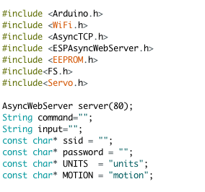
Configuring Wi-Fi
Station mode
softAP mode

Slide 53
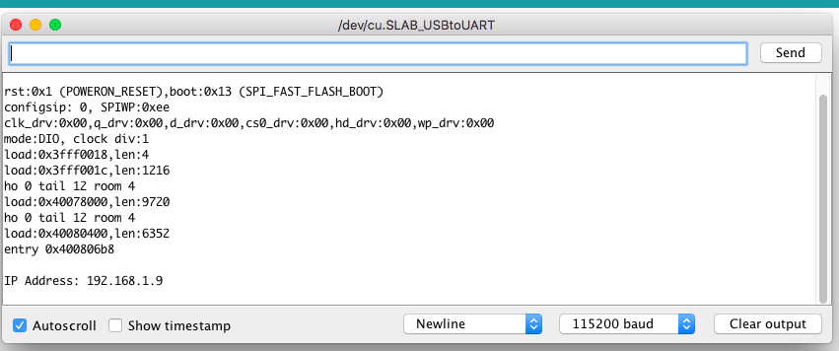

Slide 54
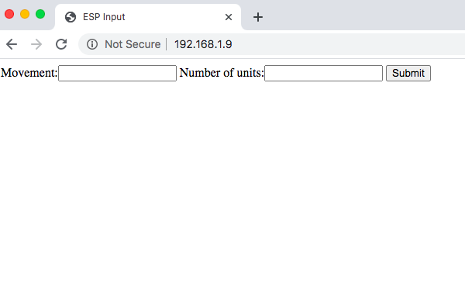
COMMANDS
forward
backward
right
left

Slide 55
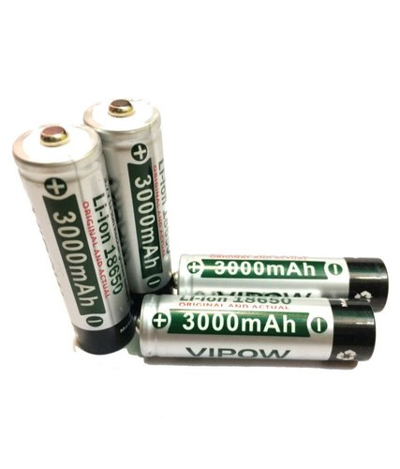
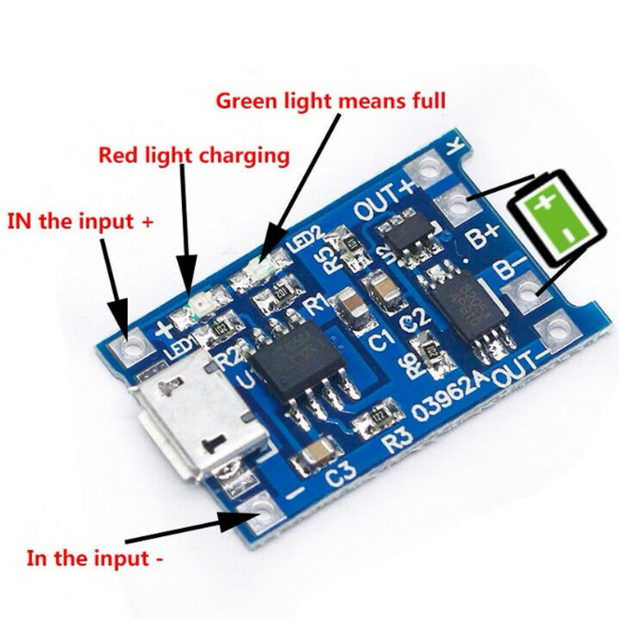
BATTERY MANAGEMENT SYSTEM
18650 3.7V BATTERY
TC4056
LIST
2 X 3.7V 3000mAhBATTERY IN SERIES
2 X TC4056 CHARGING MODULE

Slide 56
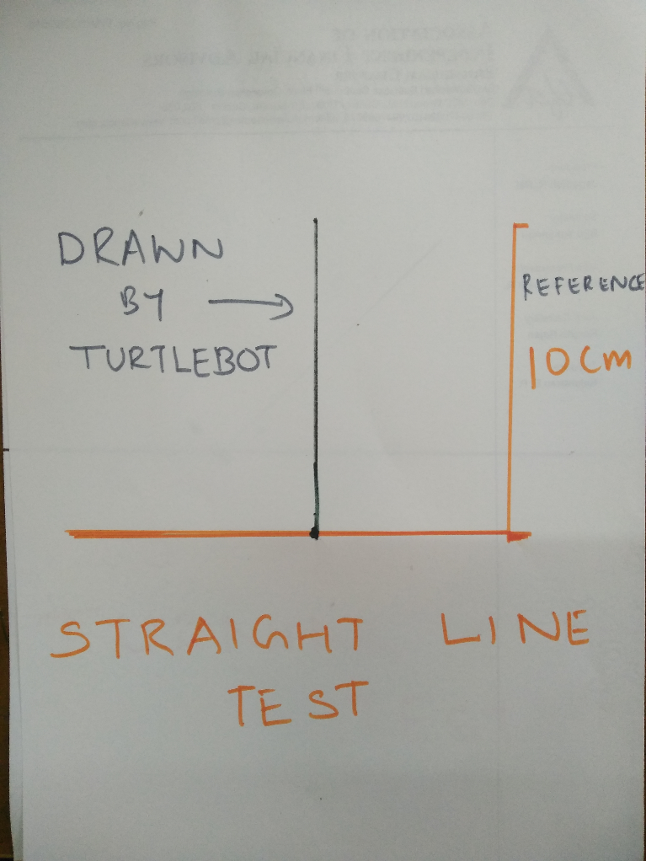
TESTING
Straight line test

Slide 57
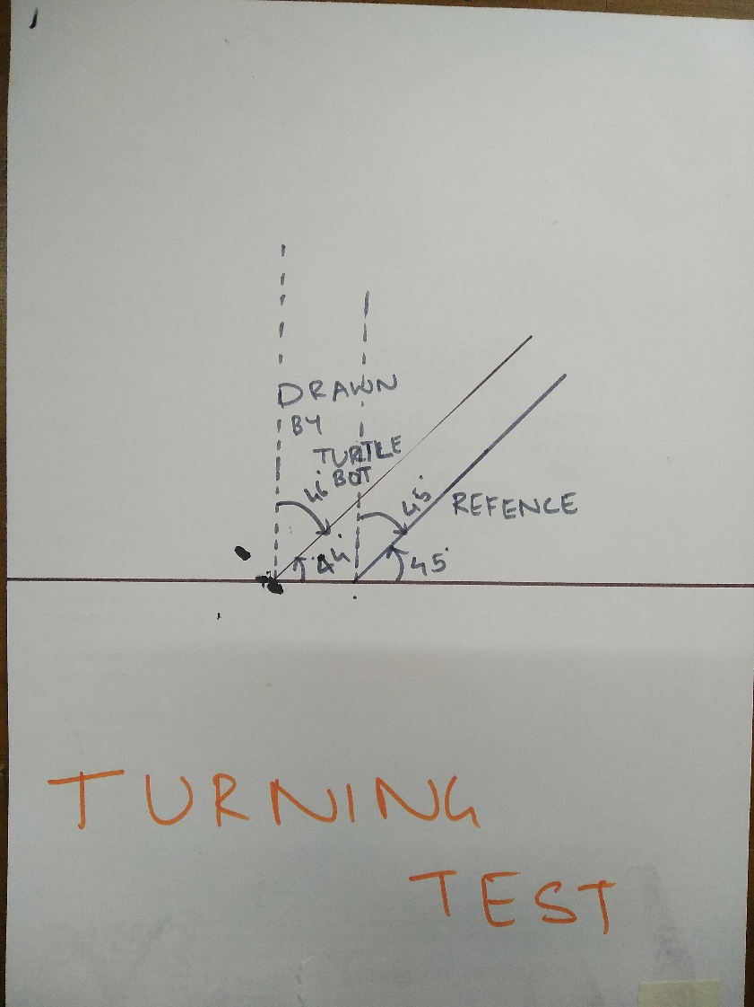
Angle test

Slide 58
Links to videos
Giving basic commands to turtle bot:https://drive.google.com/file/d/1lqURgPejlmygs-NDymq2YInCCsQGx-_8/view?usp=sharing
Straight line test
https://drive.google.com/file/d/12NjBvPkTxHSuO2kUyQ-ttJPAmx2gdVkI/view?usp=sharing
Angle test
https://drive.google.com/file/d/182E2UXXKGur9vsdOEEpNczUd_yS9xaC5/view?usp=sharing
The link for the video for setting up the WiFi on ESP32 is
https://drive.google.com/file/d/1_KRV_31bVkH0IzDSp_PRCWEgpMbcHOPk/view?usp=sharing

Slide 59
Links for our videos
The link for WiFi control of the robot
1) Forward motion: https://drive.google.com/file/d/14-rpY3t9FzSPlW_7IvS5MGizevIk8Cao/view?usp=drivesdk
2) Backward motion: https://drive.google.com/file/d/1li_B-5eQ-PNpNNRiwqN2KZFJyDKmZGaq/view?usp=drivesdk
Turtlebot tries to draw ‘A’
https://drive.google.com/file/d/1TyyJFoYREN8ObCxuNGViKgtV5nu6_u5t/view?usp=sharing
Turtlebot tries to draw a circle
https://drive.google.com/file/d/1AY-KWkjH9jjBOrNws6DDFNbZUIFBGZbY/view?usp=sharing
Turtlebot executing multiple commands sequentially
https://drive.google.com/file/d/1zIjFVV1Mzp06uLFbJJ4eIzD-28XZ1Gmr/view?usp=sharing

Slide 60
Turtlebot
3D Modeling
-Dhammapada Mohapatra

Slide 61
Importance and need of 3D modeling
Firstly its a quantitative approach towards designing and assembly of components.
It gives exact position, relative position and distance, orientation of various components in an assembly.
Secondly it is quite easy for interpretation by any person and give his/her feedbacks.
Thus always giving a scope to rectify any error and simultaneously providing opportunity for further upgradation of the project.
Hence always better than trial and error method of approach.

Slide 62
Software Selection
It is preferred to use Open Source software for the project.
For this purpose selection was made between Open S CAD, BRL CAD, Free CAD and similar other software.
On a personal note, I am comfortable with drag and drop based approach of modelling and hence FreeCAD v0.18 was selected for 3D modeling.

Slide 63
Work flow
Entire 3D modeling was divided into 5 parts:
A primary and rough chassis design (subjected to changes at every next stage)
Electro-Mechanical assembly
Electrical assembly
Battery management system
Pen lifting and lowering mechanism

Slide 64
Rough design of chassis
Various chassis design were made initially and on basis of following constraints selection was made:
Weight and torque balancing
Specific orientation of mechanical & electro -mechanical equipments
Geometry of components
A selected design drawn on orthographic paper is attached in the next slide
Also in the figure, additive tolerance of one to two millimeters is given o the components.

Slide 65
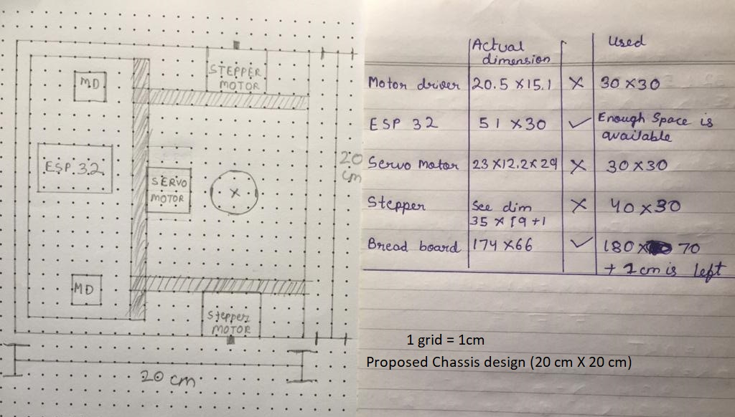
Proposed 20X20 cm chassis

Slide 66
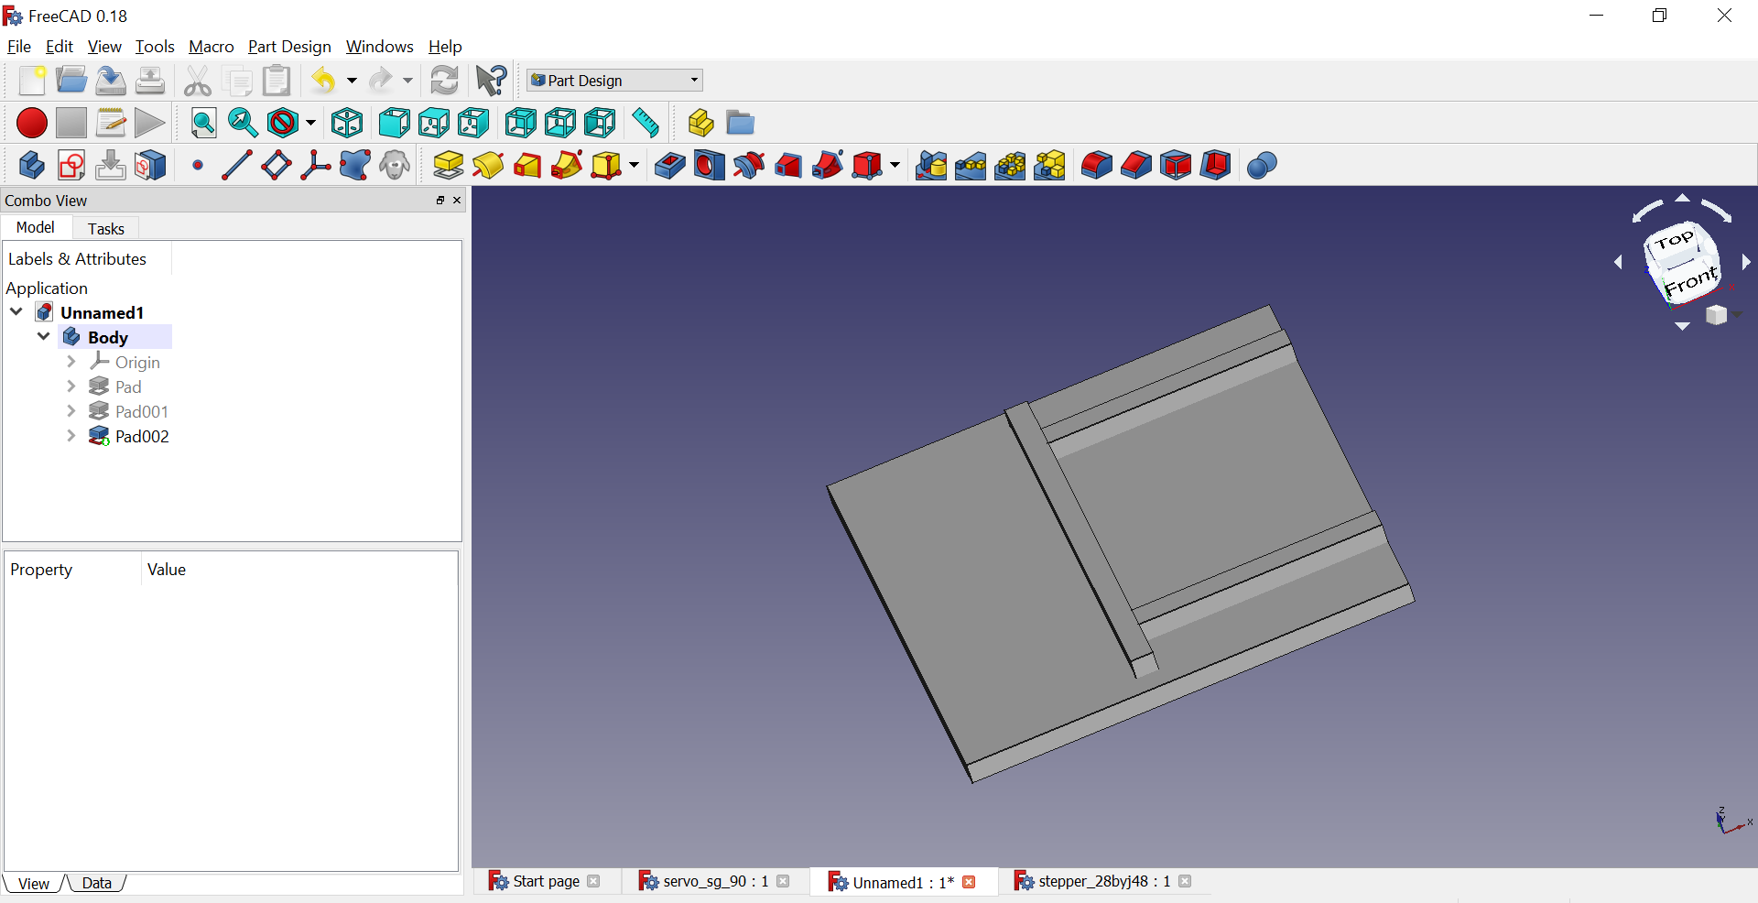
Changes in Chassis design
Basic design

Slide 67
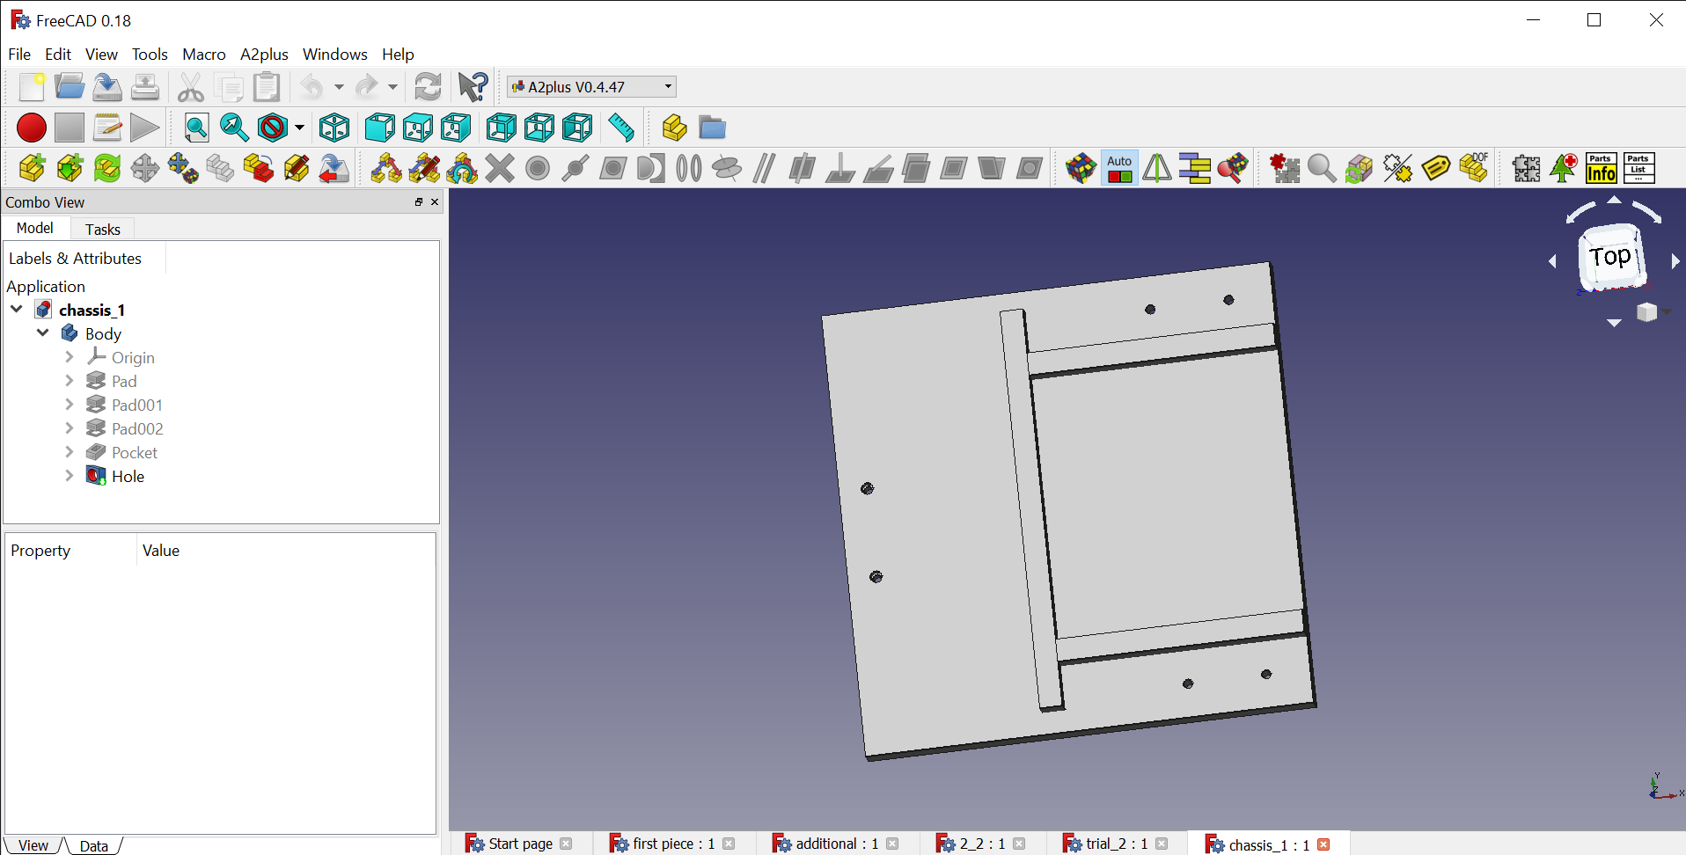
Changes in Chassis design
Chassis with holes :
Front : Caster Ball : M2
Rear : stepper motor brackets : M5

Slide 68
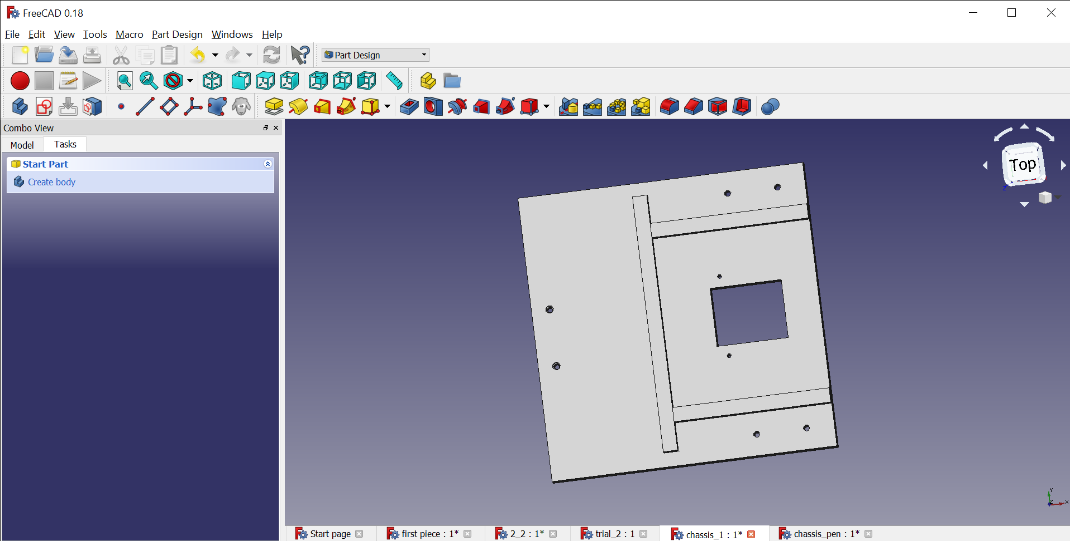
Changes in Chassis design
With added holes for pen lifting and lowering techniques

Slide 69
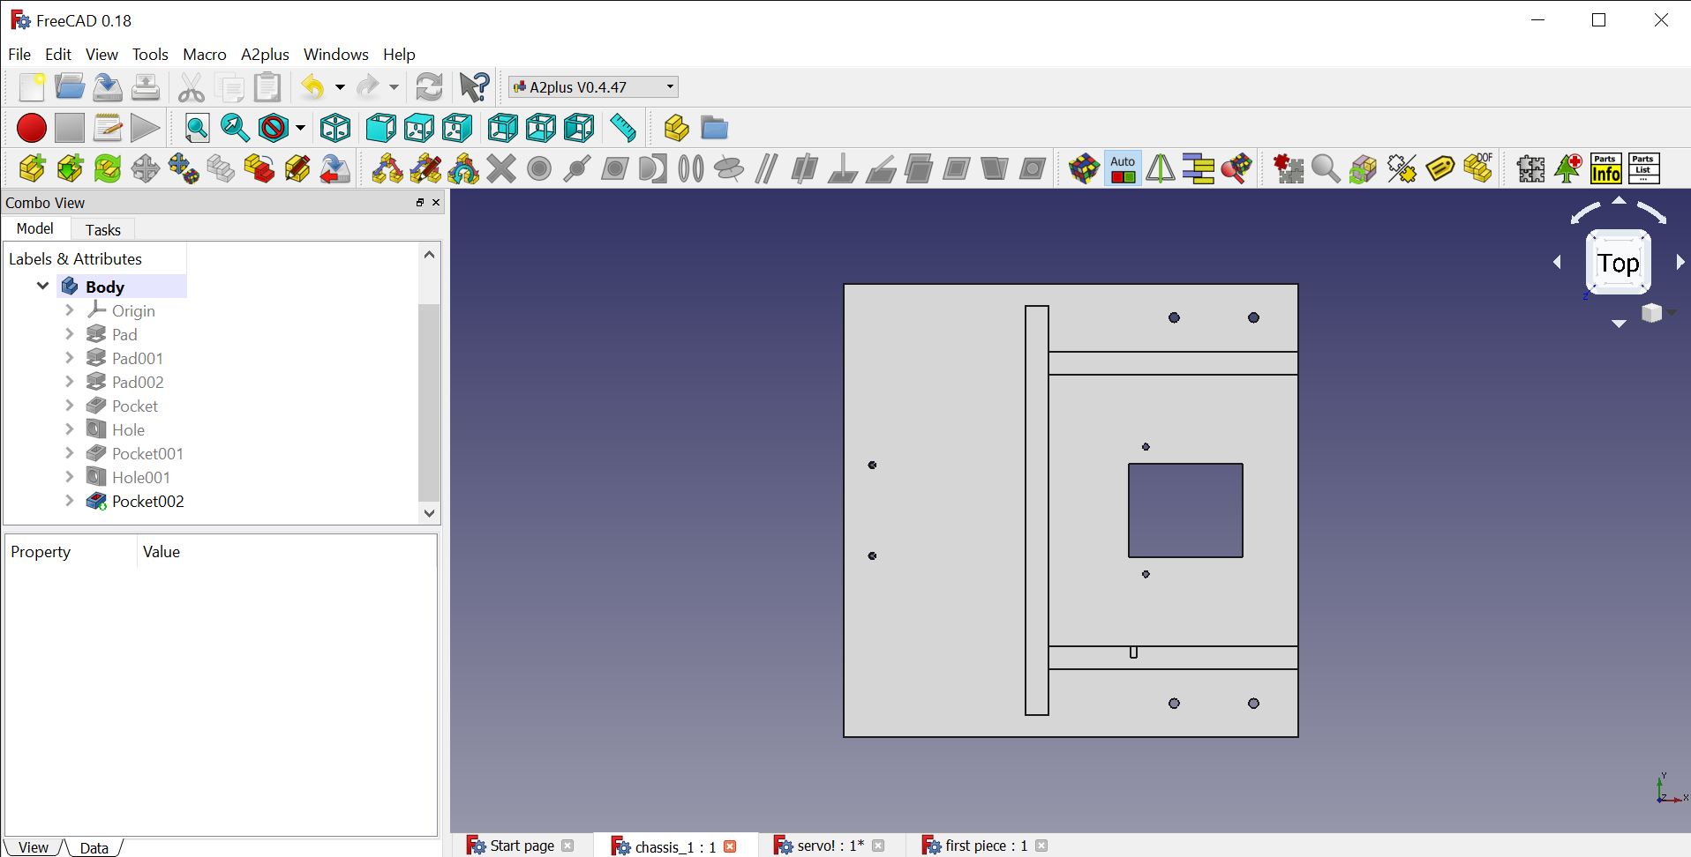
Changes in Chassis design
With added cut on lower support wall to accommodate servo motor

Slide 70




Electro mechanical assembly
It involves attachment of wheels, caster ball, stepper motor, support brackets with the chassis via fasteners
Assembly: https://youtu.be/6wjJIstEaW0
Exploded assembly : https://youtu.be/zw7gvPr8HGQ

Slide 71

Electro mechanical assembly

Slide 72



Electrical Assembly
It involves electrical parts –
ESP 32 DEVKITC (Micro-controller)
Motor Driver (DRV8825)
Breadboard (170.5X 63.1X 8.4 mm)

Slide 73


Design of Breadboard
Complete design was done on basis of attached dimension

Slide 74
Design of Breadboard
A lot of variables were missing and gave rise to errors
Dimension of single hole is missing
Position of at least one hole from either the ends are missing
Inter-distancing of holes of various rows and columns are missing
Design of breadboard :
https://youtu.be/nMw-iiXcBq8

Slide 75
Electrical Assembly

Slide 76



Battery management system
For this purpose we used TC4056 charging module, Li ion battery (3.7v) and a battery holder.

Slide 77

Battery management system

Slide 78

Pen Lifting and Lowering Mechanism
Sliding mechanism were preferred.
Assembly of servo motor with mechanism.

Slide 79

Pen Lifting and Lowering Mechanism
Another mechanism i.e. Rack and pinion mechanism was also proposed
It involves a spur gear (pinion) and a toothed slider called as rack. Gear is attached to servo motor and it meshes with rack. It also has a casing for rack to fix its position.

Slide 80
Pen Lifting and Lowering Mechanism
Out of the two mechanism sliding was preferred because as in case of rack and pinion mechanism, there is a higher probability that it may not work either due to lack of meshing (even a bit of inaccuracy may lead to failure) and other factors like over and undercutting of meshed tooth.

Slide 81

Result: Combined assembly with fasteners attached

Slide 82
Result: Combined assembly with fasteners attached

Slide 83
Some other important points
Thick wheels were preferred to increase friction and reduce the momentum of bot thus allowing a smooth and non-sliding turn.
Discussion were held on orientation of pen holding part (i.e. tilt or no tilt) and its impact on friction . In conclusion the weight of pen is balanced by pen holding part and not by ground. Thus it’s a zero normal contact and hence weight of pen doesn’t play in determining friction.

Slide 84
Links for design and assembly:
https://youtu.be/nMw-iiXcBq8 - breadboard design 1
https://youtu.be/Kqc17-Jy2LI - breadboard 2/electrical assembly
https://youtu.be/WBas0Xoxg9Q - electrical and electromechanical assembly
https://youtu.be/Vnx021O-YiY - wheel design
https://youtu.be/UswX56JsxDY - 9V dc battery design
https://youtu.be/pRFn5OuC8Yc - exploded trial assembly (prefinal)
https://youtu.be/6wjJIstEaW0 - electro-mechanical assembly
https://youtu.be/zw7gvPr8HGQ - exploded electromechanical assembly
https://youtu.be/dIWP_I81fDU - exploded electrical assembly
https://youtu.be/EHoBY8gCtp8 - exploded assembly pre-final
https://youtu.be/eRUBuXxHkuU - exploded assembly final

